Slide 1
Data Communication & Networking
(DCN)
Department of Computer Science PAF-KIET
Course Instructor
Hira Beenish

Slide 2
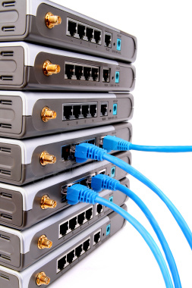
About This Course
Course name Data Communication and Networking
Credit 3 hours
Abbreviation DCN
Prerequisite none
Type of Course Major
Course Description Introduction to OSI layers, Classifications and Topologies, Data Transmission issues and channel impairments, Encoding Techniques, Error Detection and Correction, Multiplexing and Codes, Packet Switching, Circuit Switching, Public Switched Telephone Network and ATM.

Slide 3
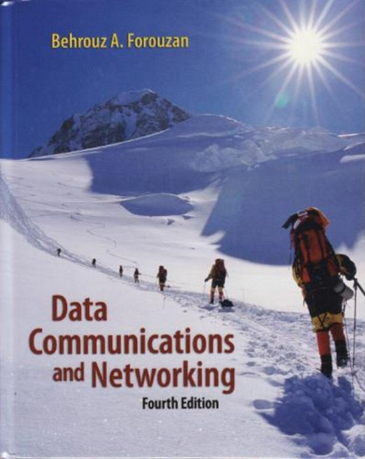

Course Material
Textbooks
Behrouz A Forouzan (2007), Data Communications and Networking, 4 / e, McGraw-Hill, New York.
Reference Books
[1] William Stallings (2011), Data and Computer Communications, 8 / e, PEARSON Prentice Hall, USA.
[2] Andrew S.Tanenbaum
Computer Networks

Slide 4
Course Assessment
Final Examination 40%
Midterm Examination 20%
Assignments 5%
Quiz 10%
Projects 15%
Labs 10%

Slide 5
Chapter 1 - Introduction

Slide 6
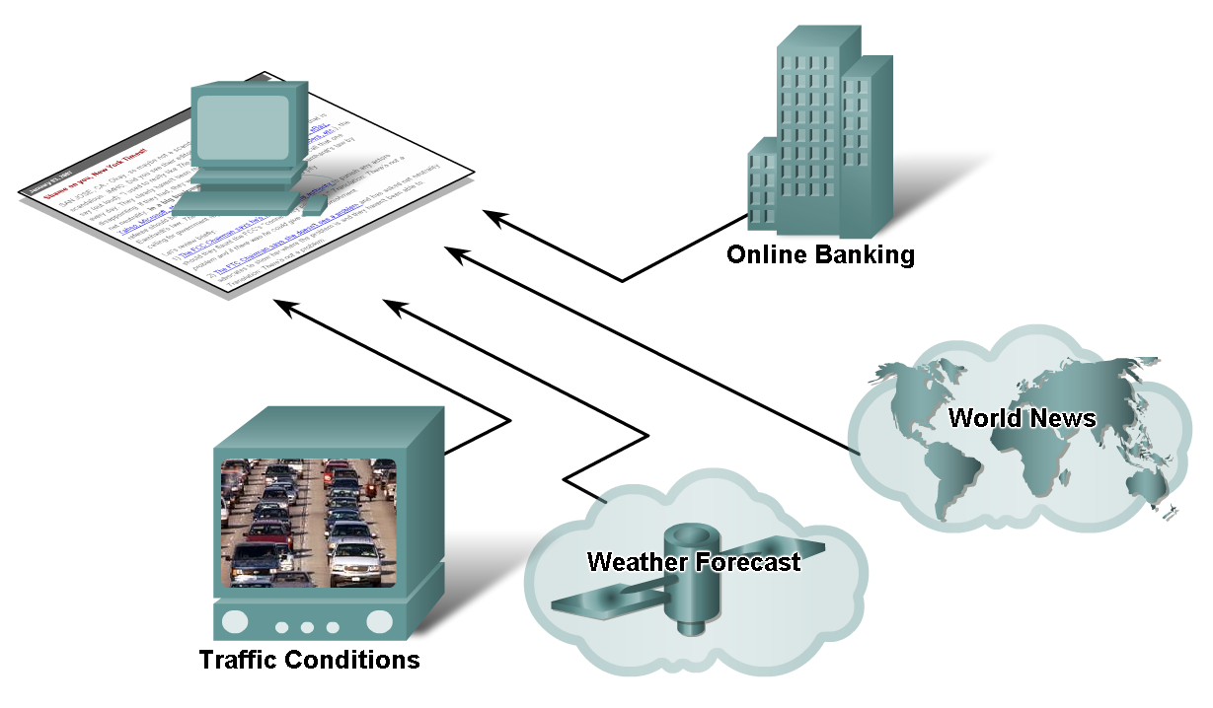
How Networks Impact Daily Life
The benefits of instantaneous communication and
how it supports and improves our lives

Slide 7
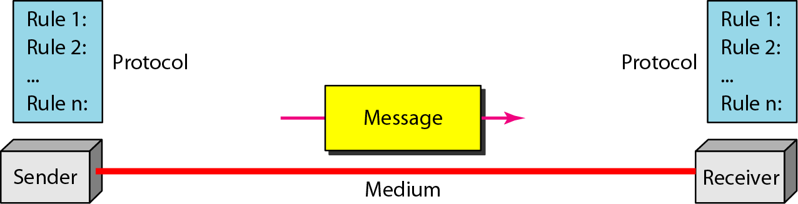
Five Components of Data Communication
Message: Information (data) to be communicated such as text, numbers, pictures, sound, video or any combination thereof.
Sender : device that sends the message. It can be a computer, telephone handset, video camera, etc.
Receiver : device that receives the message
Transmission medium: Physical path by which a message travels
Protocol: A set of rules that govern data communication
Notes:
Message: Information (data) to be communicated such as text, numbers, pictures, sound, video or any combination thereof.
Sender: device that sends the message. It can be a computer, telephone handset, video camera, etc.
Receiver: device that receives the message.
Transmission Medium: The physical path by which a message travels from sender to receiver. It could be a cable (twisted pair, coaxial or fiber-optic) or radio waves (terrestrial or satellite microwave).
Protocol: Set of rules that govern data communications. Is represent an agreement between the communicating devices.

Slide 8
Data Communications
Data
Information presented in whatever form is agreed upon by the parties creating and using the data
Data communication
Exchange of data between two devices
Via some form of transmission medium
Fundamental characteristics of data communication
Delivery: The system must deliver data to the correct destination
Accuracy: The system must deliver the data accurately
Timeliness: The system must deliver the data in a timely manner. In the case of video and audio timely delivery mean real-time transmission.
Jitter : Variation in the packet arrival time
Telecommunication: communication at a distance
(‘tele’ in Greek=‘far”)

Slide 9
Data Representation
Text – In data communications, text is represented as a bit
pattern, a sequence of bits (Os or 1s).
Different sets of bit patterns have been designed to
represent text symbols. Each set is called a code, and the process of representing symbols is called coding. Today, the prevalent coding system is called Unicode.
Unicode, uses 32 bits to represent a symbol or character used in any language in the world.

Slide 10
Data Representation
Numbers: Numbers are directly converted to binary.
Images: A image is divided into a matrix of pixels (picture elements), where each pixel is a small dot. The size of the pixel depends on what is called resolution. For example an image can be divided into 1000 pixels or 10,000 pixels. Each pixel is assigned a bit pattern. Black and white images: 1 bit. Gray scale images: 2 bits (black, dark gray, light gray and white). Colored images: Each pixel is decomposed into primary colors: Red, Green and Blue (RGB). 8 bits are usually used to represent the intensity of each color.

Slide 11
Data Representation
Audio: A representation of a sound. Audio is by nature different from text, numbers or images. It is continuous not discrete. Audio can be changed to a digital or an analog signal.
Video: Can be produced either as a continuous entity (e.g., by a TV camera) or it can be a combination of images, each a discrete entity, arranged to convey the idea of motion. We can change video into a digital or an analog signal.

Slide 12
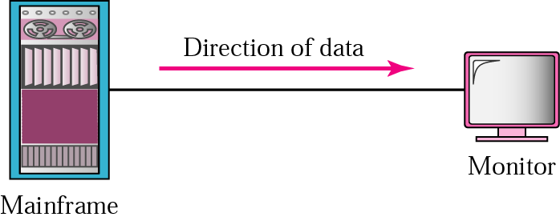
Direction of Data Flow
Simplex
Unidirectional
As on a one-way street

Slide 13

Direction of Data Flow (cont)
Half-duplex
Both transmit and receive possible, but not at the same time
Like a one-lane road with two-directional traffic
Walkie-talkie, CB radio

Slide 14

Direction of Data Flow (cont)
Full-duplex
Transmit and receive simultaneously
Like a two-way street, telephone network
Channel capacity must be divided between two directions

Slide 15
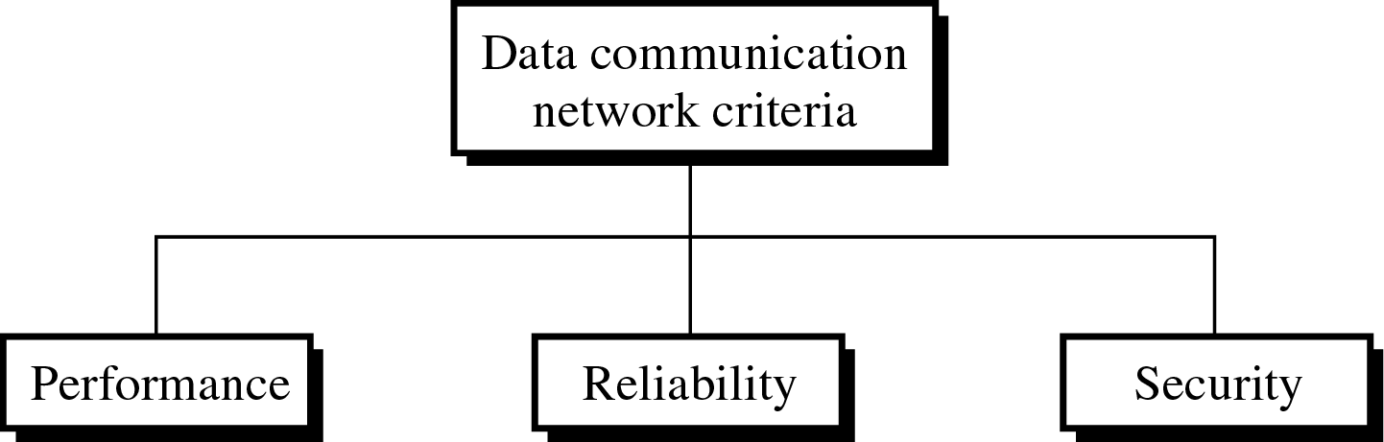
Network
Network: A set of devices (nodes) connected by communication links
Node: Computer, printer, or any device capable of sending and/or receiving data
To be considered effective and efficient, a network must meet a number of criteria

Slide 16
Network Criteria
Performance: Can be measured by transit time and response time. Transit time is the amount of time required for a message to travel from one device to another. Response time is the elapsed time between an inquiry and a response. The performance of a network depends on the number of users, the type of transmission medium, the capacities of the connected hardware and the efficiency of the software.
Reliability: Is measured by the frequency of failure, the time it takes a link to recover from failure and the network robustness in a catastrophe.
Security: Protecting data from unauthorized access.

Slide 17
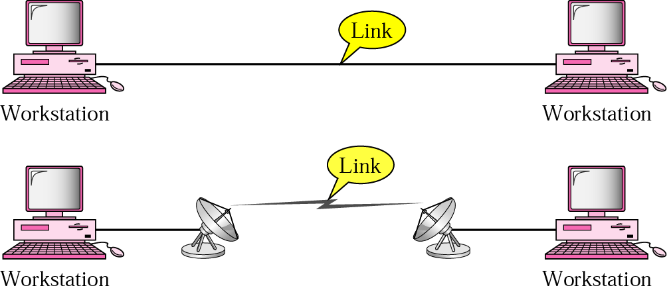
Types of Connections
Point-to-point
Dedicated link between two devices
The entire capacity of the channel is reserved
Ex) Microwave link, TV remote control

Slide 18
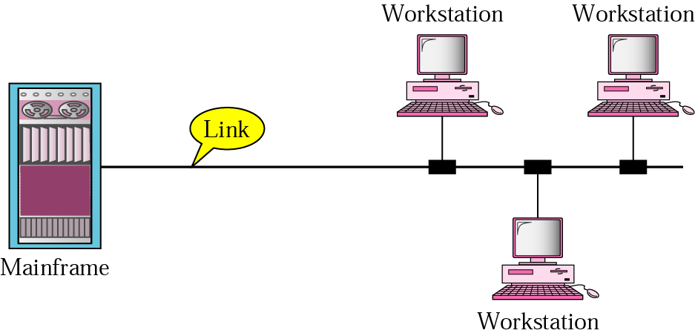
Types of Connections (cont)
Multipoint
More than two devices share a single link
Capacity of the channel is either
Spatially shared: Devices can use the link simultaneously
Timeshare: Users take turns

Slide 19
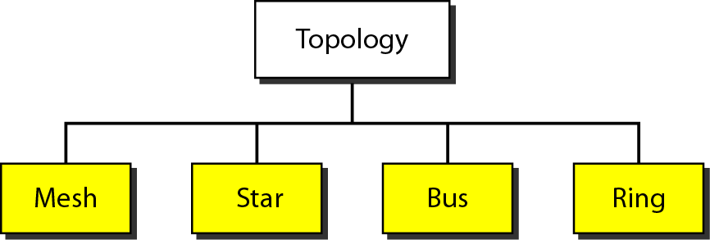
Physical Topology
The way in which a network is laid out physically
4 basic types: mesh, star, bus, ring
May often see hybrid

Slide 20
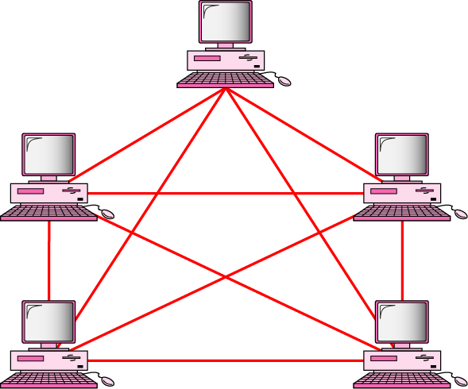
Mesh Topology
Dedicated point-to-point link to every other nodes
A mesh network with n nodes has n(n-1)/2 links. A node has n-1 I/O ports (links)
Advantages: No traffic problems, robust, security, easy fault identification & isolation
Disadvantages: Difficult installation/reconfiguration, space, cost
Notes:
Mesh Topology: Every device has a dedicated point-to-point link to every other device resulting in n(n-1)/2 links for n devices and each device having (n-1) input/output (I/O) ports (see Fig. 1.8).
Advantages:
Eliminate traffic problems.
Privacy and security. Easy fault identification and fault isolation.
Robustness. If one link becomes unusable, it does not incapacitate the entire topology.
Disadvantages:
Big amount of cabling makes installation and reconnection difficult.
Wiring can be greater than available space (walls, ceiling, floors).
Big number of I/O ports required. Hardware required will be very expensive.
Mesh is implemented in a limited fashion (as a backbone topology).

Slide 21
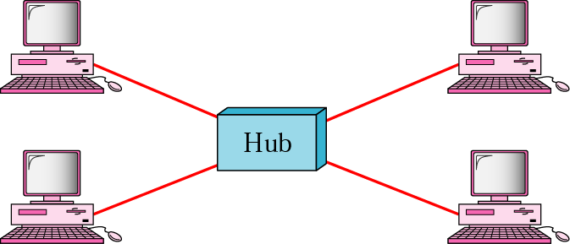
Star Topology
Dedicated point-to-point link only to a central controller, called a hub
Hub acts as an exchange: No direct traffic between devices
Advantages: Less expensive, robust
Disadvantages: dependency of the whole on one single point, the hub
Notes:
Star Topology: Each device has a dedicated point-to-point link only to a central controller (hub). The hub acts as an exchange between nodes (see Fig. 1.9)
Advantages:
Less expensive than mesh topology. Each device needs only one link and one I/O.
Easy to install and reconfigure.
Far less cabling needs to be housed compared with mesh topology and additions, moves and deletions involve only the connection between a node and the hub.
Robustness.
Easy fault identification and fault isolation.

Slide 22
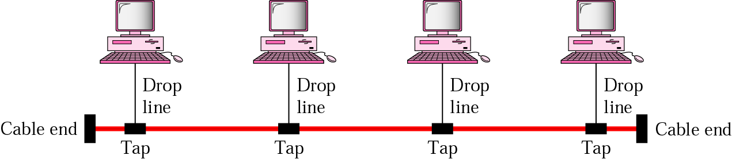
Bus Topology
One long cable that links all nodes
tap, drop line, cable end
limit on the # of devices, distance between nodes
Advantages: Easy installation, cheap
Disadvantages: Difficult reconfiguration, no fault isolation, a fault or break in the bus stops all transmission
Notes:
Bus topology:Is a multipoint connection. One long cable acts as a backbone to link all devices in a network (Fig 1.10). Nodes are connected to the cable by drop lines and taps. As the signal travels along the backbone, some of its energy is transformed to heat and thus is weakened. As such there is a limit on the number of taps a bus topology can support and on the distance between those taps.
Advantages:
Ease of installation
Less cabling than mesh or star topology
Disadvantages:
Difficult to add devices
Signal reflection in taps can cause degradation in quality
A fault or break in the bus cable stops all transmission

Slide 23
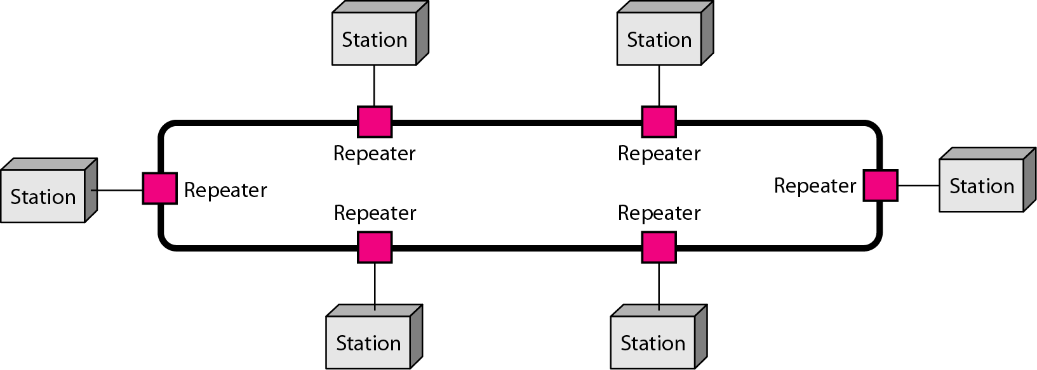
Ring Topology
Dedicated point-to-point link only with the two nodes on each sides
One direction, repeater
Advantages: Easy reconfiguration, fault isolation
Disadvantage: Unidirectional traffic, a break in the ring cab disable the entire network
Notes:
Ring: Each device has a dedicated point-to-point connection only with the two devices on either side of it. A signal is passed along the ring in one direction, from device to device, until it reaches its destination. Each device in the ring incorporates a repeater. When a device receives a signal intended for another device, its repeater generates the bits and passes them along (see Fig. 1.11)
Advantages:
Easy to install and configure. The only constraints are media and traffic consideration (maximum ring length and number of devices).
Fault isolation is simplified.
Disadvantages:
In a simple ring (unidirectional), a disable station can disable an entire network. This can be solved by using a dual ring.

Slide 24
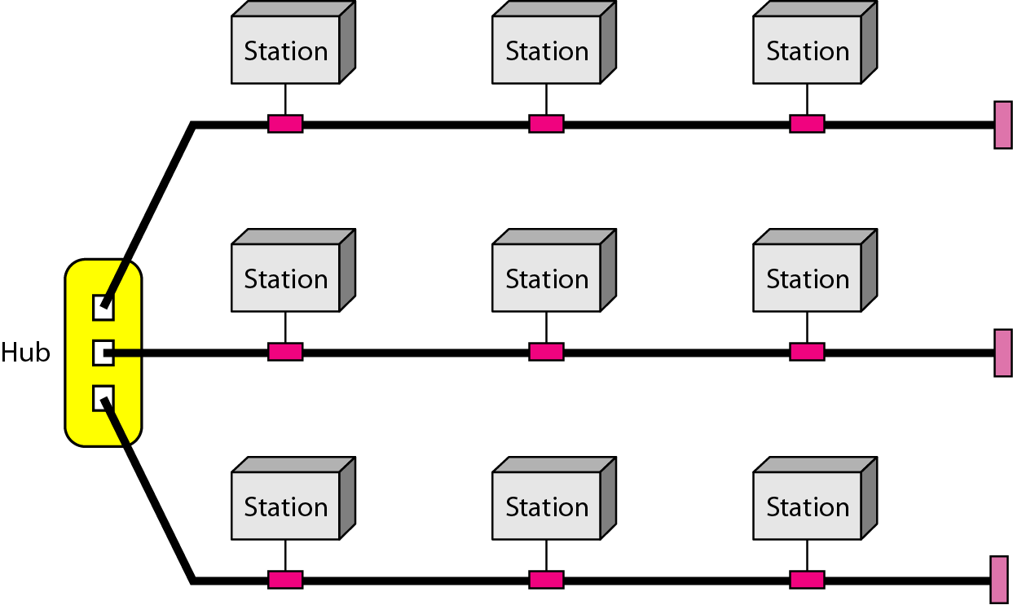
Hybrid Topology
Example: Main star topology with each branch connecting several stations in a bus topology
To share the advantages from various topologies

Slide 25
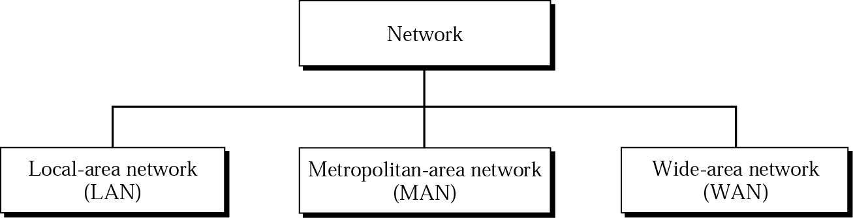
Categories of Networks
LAN – smaller geographical area
MAN – media geographical area
WAN – large geographical area

Slide 26
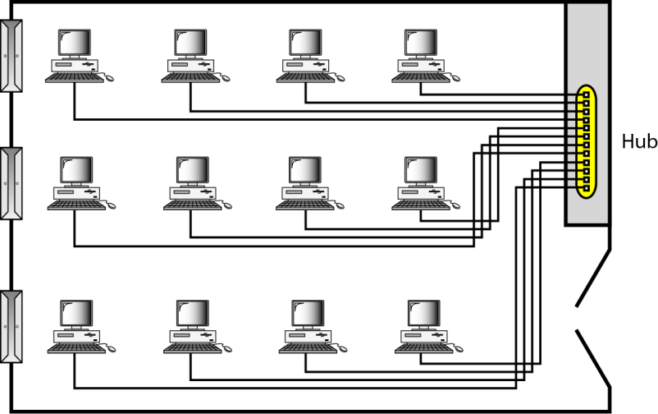
LAN
Usually privately owned
A network for a single office, building, or campus ≤ a few Km
Common LAN topologies: bus, ring, star
An isolated LAN connecting 12 computers to a hub in a closet

Slide 27
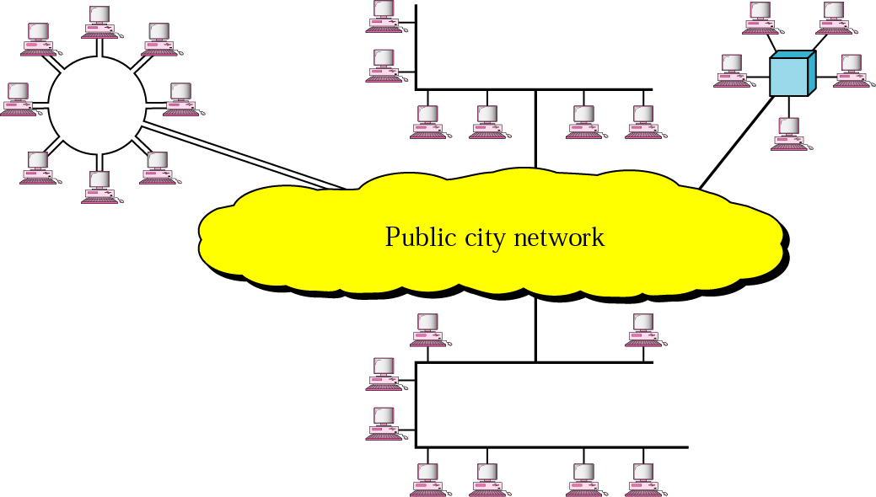
MAN
Designed to extend to an entire city
Cable TV network, a company’s connected LANs
Owned by a private or a public company

Slide 28
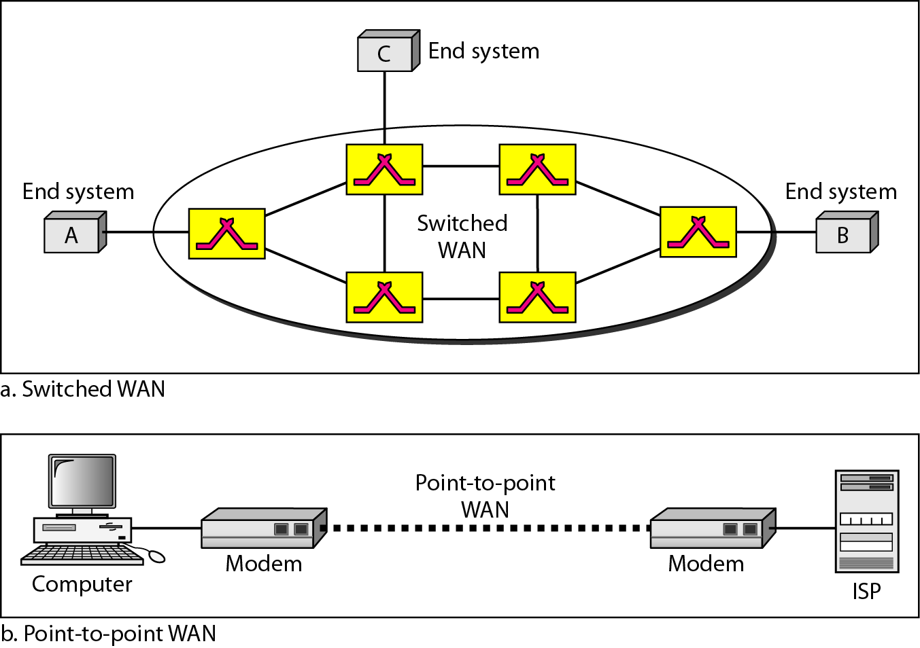
WAN
Long distance transmission, e.g., a country, a continent, the world
Enterprise network: A WAN that is owned and used by one company

Slide 29
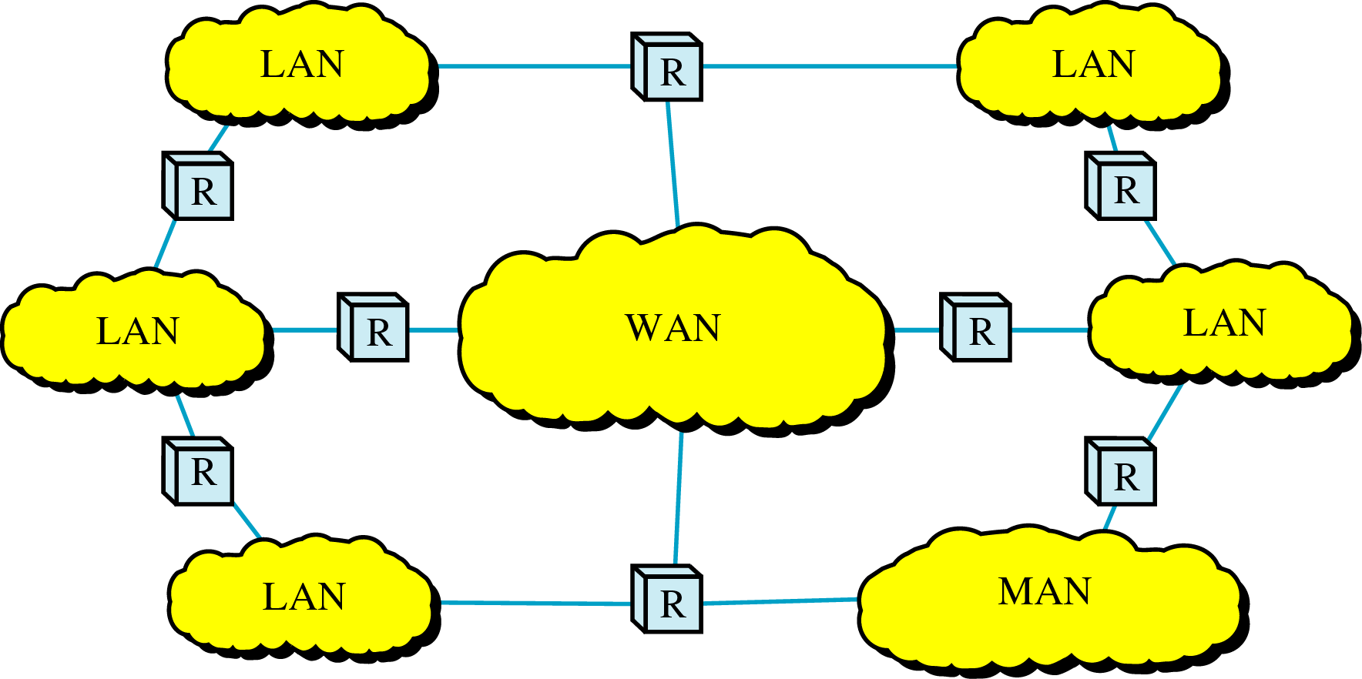
Internetwork
Internetwork (internet) : two or more networks are connected by internetworking devices
Internetworking devices: router, gateway, etc.
The Internet: a specific worldwide network

Slide 30
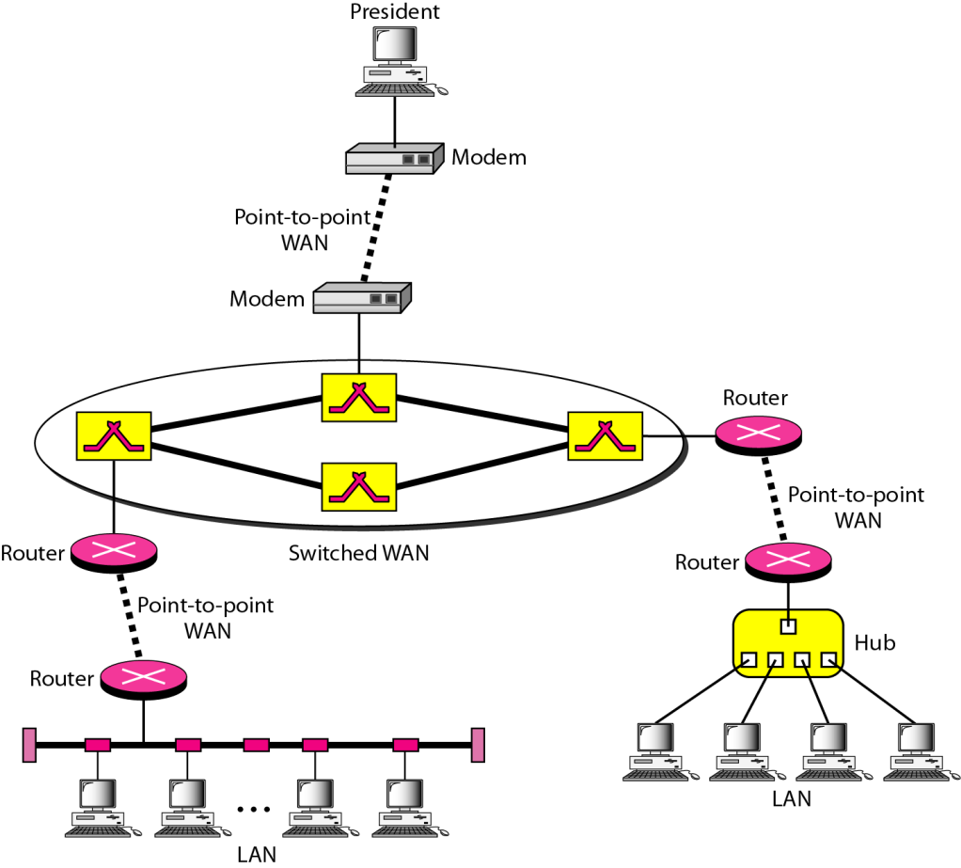
Internetwork Example
A heterogeneous network : four WANs and two LANs

Slide 31
The Internet
The Internet has revolutionized many aspects of our daily lives. It has affected the way we do business as well as the way we spend our leisure time. The Internet is a communication system that has brought a wealth of information to our fingertips and organized it for our use.
1967: ARPANET proposed by DoD’s ARPA(Advanced Research Project Agency)
1969: ARPANET in a reality: UCLA, UCSB, SRI, U. of Utah
1973: Vint Cerf and Bob Kahn propose TCP,
To split TCP into two protocols TCP and IP

Slide 32
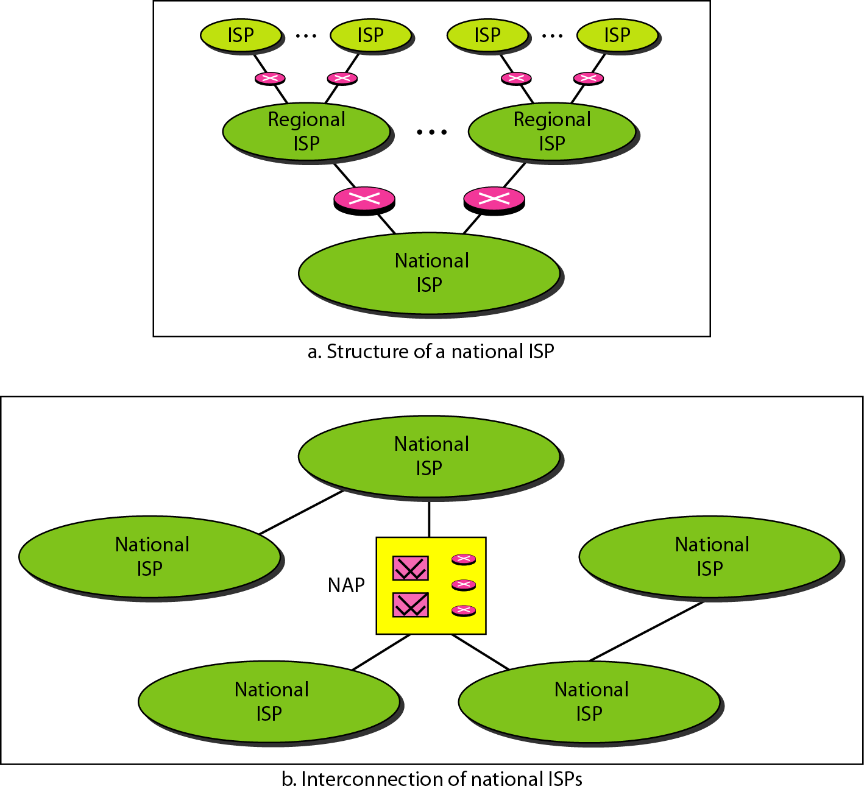
Internet Today
ISP (Internet service providers)
NISP (national ISP)
Notes:
International Service Providers: Connect nations together.
National Service Providers (NSPs): Backbone networks created and maintained by specialized companies. NSPs are connected by complex switching stations (normally run by third party) called Network Access Points (NAPs).

Slide 33
Protocols
Protocol : rule
A set of rules that govern data communication
For communication to occur, entities must agree upon a protocol
Notes:
A protocol is a set of rules that govern data communication. It defines what, how and when something is communicated. The key elements of a protocol are as follows:
Syntax: structure or format of the data (order in which they are presented)
Semantics: Meaning of each portion of bits
Timing: When and how fast data should be sent.

Slide 34
Standards: agreed-upon rules
Standards is essential in
Creating/maintaining open and competitive markets
Guaranteeing national/international interoperability
Two categories
De jure (“by law” or “by regulation’) standards
De facto (“by fact” or ‘by convention’) standards
Proprietary standards: closed standards
Nonproprietary standards: open standards
Notes:
Standards provide guidelines to manufacturers, vendors, government agencies and other providers to ensure the kind of interconnectivity necessary in today’s market place and in international communication. There are two types of standards:
De facto: Standards that have not been approved by an organized body but have been adopted as standards through widespread use.
De Jure: Standards that have been legislated by an officially recognized body.

Slide 35
Standards Organizations
Standards are developed by
Standards creation committees
Forums
Regulatory agencies
Standards committees & forums
Standards committees are slow moving
Forums are made up of interested corporations
Forum are able to speed acceptance of a particular technology

Slide 36
Standards Committees
ISO (International Standard Organization)
Voluntary international organization
ITU-T (International Telecommunication Union- Telecommunication)
Formerly, CCITT formed by UN
ANSI (American National Standards Institute )
Private non-profit corporation in the US
IEEE (Institute of Electrical and Electronics Engineers )
The largest engineering society in the world
EIA (Electronic Industries Association )
Non-profit organization in the US
Notes:
International Organization for Standardization (ISO): Develop cooperation in scientific, technological and economic activities.
International Telecommunication Union- Telecommunication Standards Sector (ITU-T) formerly (before March 1993) Consultative Committee for International Telegraphy and Telephony (CCITT): Set-up by the United Nations.
American National Standards Institute (ANSI): Despite its name ANSI is a completely private, nonprofit corporation not affiliated to the US federal government.
Institute of Electrical and Electronics Engineers (IEEE): Largest professional engineering society in the world. One of the goals of IEEE is to oversee the development and adoption of International standards for computing and communications.
Electronic Industries Association (EIA): Aligned with ANSI. In IT EIA has made significant contributions by defining physical connection interfaces and electronic signaling specifications for data communications.

Slide 37
Internet Standards
IETF (Internet Engineering Task Force)
Internet Draft
working document with no official status
with a 6-month lifetime
RFC (Request for Comment)
Edited, assigned a number, and made available to all interested parties
Notes:
Forums: Standard committees are procedural bodies and by nature slow-moving. Special Interest Groups (SIGs) have developed forums made up of representative from interested corporations. Forums test, evaluate and standardize new technologies. Forums present their conclusions to standard bodies.
Regulatory agencies: All communication technology is subject to regulation by government agencies such as the Federal Communications Commission (FCC) in the US. FCC’s purpose is to protect public interest by regulating radio, TV and wire/cable communications.
Internet Standards: An internet standard is a thoroughly tested specification that is useful to and adhered to by those who work with the Internet. It starts as a Internet draft- a work in progress document with a 6 months validity. Upon approval the draft may be published as a Request for Comment (RFC).

Slide 38
Thank You

